Slide 1
COMP5423 Natural Language Processing

Slide 2
Text Classification
and Ranking

Slide 3
Outline
Learning Objectives
Text Classification
Classification Models
Linguistic Features
Text Ranking
Relevance and Cosine Similarity
Bag-of-Word Retrieval vs. Dense Retrieval

Slide 4
Text Classification
Text Classification Tasks
Binary Classification
Sentiment Classification: Determines whether the sentiment orientation that a writer expresses towards some object is positive or negative.
Email Spam Detection: Detects whether an email is spam or not.
Multi-Class Classification
News Categorization: Identifies the topic that a news talks about, such as business, technology, entertainment, sports, science and health, etc.

Slide 5

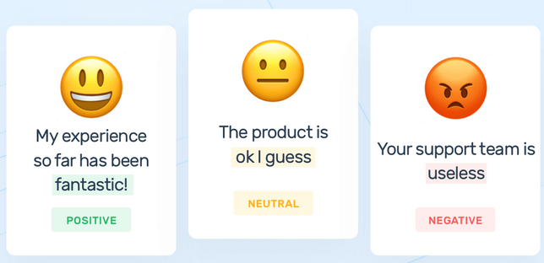
Text Classification
Sentiment Classification
A Document
A Sentence
Binary Sentiment
Classification
Three-Class Sentiment
Classification
Positive or Negative
Positive, Negative or Neutral
A sentence may express no opinion. No opinion is usually regarded as neutral.
Notes:
Sentiment Analysis and Opinion Mining (P23):
Document sentiment classification is perhaps the most extensively studied topic. It aims to classify an opinion document as expressing a positive or negative opinion or sentiment. .. A large majority of research papers on this topic classifies online reviews.
Problem definition: Given an opinion document d evaluating an entity, determine the overall sentiment s of the opinion holder about the entity, i.e., determine s expressed on aspect GENERAL in the quintuple (_, GENERA L, s, _, _ ), where the entity e, opinion holder h, and time of opinion t are assumed known or irrelevant (do not care).
Assumption: Sentiment classification or regression assumes that the opinion document d (e.g., a product review) expresses opinions on a single entity e and contains opinions from a single opinion holder h. This assumption holds for reviews of products and services because each review usually focuses on evaluating a single product or service and is written by a single reviewer.
If sentiment takes categorical values, e.g., positive and negative, then it is a typical classification problem.
If sentiment takes numeric values or ordinal scores within a given range, e.g., 1~5, the problem becomes regression.
Most existing techniques for document-level classification use supervised learning, although there are also unsupervised methods. Sentiment regression has been done mainly using supervised learning.

Slide 6

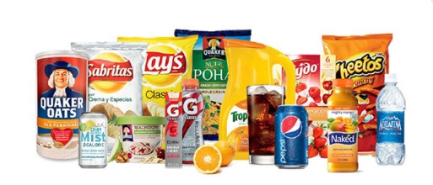
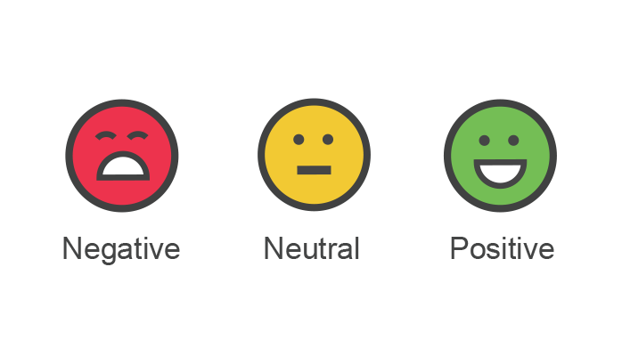
Text Classification
Sentiment Classification
Information
Extraction
(Named) Entity
Extraction
Co-Reference
Resolution
Opinion Holder Opinion Target Sentiment
Sentiment Analysis and Opinion Mining
Text
Classification

Slide 7
Text Classification
Sentiment Classification
Supervised Classification: Training Corpus
+
+
+
-
-
It is a very amazing product.
Just received this camera two days ago and already love the features it has.
By cocking the shutter to the halfway position and getting the settings ready to shoot, I was able to produce excellent stopaction photos.
It feels slow to focus, and unbearably slow to shoot.
The adobe camera raw plug-in shows once again that hardware is miles ahead of software.
……
Sample Training Data

Slide 8
Text Classification
Sentiment Classification
Supervised Classification: Training Corpus
Feature Design
and Extraction
Features
Model
Selection
Training
Sentiment
Labeled
Text
Classification
Model
Positive or Negative
Notes:
Sentiment Analysis and Opinion Mining (P24):
Sentiment classification is essentially a text classification problem. Traditional text classification mainly classifies documents of different topics, e.g., politics, sciences, and sports. In such classifications, topic-related words are the key features. However, in sentiment classification, sentiment or opinion words that indicate positive or negative opinions are more important, e.g., great, excellent, amazing, horrible, bad, worst, etc.

Slide 9
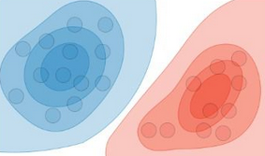
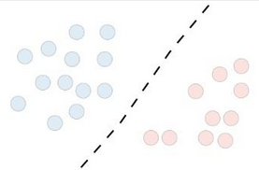
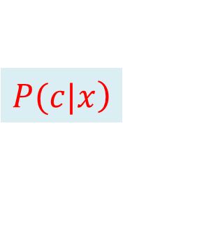
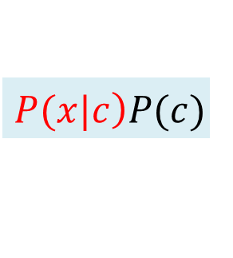
Text Classification
Sentiment Classification
Classification Models: Naive Bayes (NB), Logistic Regression (LR) (or Maximum Entropy (ME)), Support Vector Machines (SVM), Random Forests, Convolutional Neural Networks (CNN), BERT, etc.
Generative Model ( ): Naïve Bayes Classifier (see Speech and Language Processing Chapter 4)
Discriminative Model ( ): Logistic Regression Classifier (see Speech and Language Processing Chapter 5)
$$\left.P(x|c\right)P(c)$$
$$\left.P(c|x\right)$$
Notes:
Parameter Learning: Probability learning
The probability to generate the data give a class
The probability to assign a class to a given data

Slide 10
Text Classification
Sentiment Classification
Classification Features: Like other supervised machine learning applications, the key for sentiment classification is the engineering of a set of effective features.
Surface Text Features
(TF or TF-IDF Weighted) Word N-Grams, such as Word Uni-gram Features, Bi-Gram Features and etc.
Notes:
Sentiment Analysis and Opinion Mining P24:
Pang, Bo, Lillian Lee, and Shivakumar Vaithyanathan. Thumbs up?: sentiment classification using machine learning techniques. In Proceedings of Conference on Empirical Methods in Natural Language Processing (EMNLP-2002). 2002. (http://www.aclweb.org/anthology/W02-1011) (Features: Uni-gram, Bi-gram, TF or Binary, POS)
Sentiment Analysis and Opinion Mining P25:
Like other supervised machine learning applications, the key for sentiment classification is the engineering of a set of effective features.
P24:
Unigrams (a Bag of Words)
P25:
Terms and their frequency. These features are individual words (unigram) and their n-grams with associated frequency counts. They are also the most common features used in traditional topic-based text classification. The TF-IDF weighting scheme from information retrieval may be applied too. As in traditional text classification, these features have been shown highly effective for sentiment classification as well.
a, ago, also, amazing, battery, bought, camera, Canon, for, G12, heavy, her, however, I (2), is (3), it (2), life, long, love, months, my, picture, quality, simply, six, the (2), thinks, too, wife
Like other supervised machine learning applications, the key for sentiment classification is the engineering of a set of effective features.
The part-of-speech (POS) of each word can be important too. Words of different parts of speech (POS) may be treated differently. For example, it was shown that adjectives are important indicators of opinions.
Sentiment words are words in a language that are used to express positive or negative sentiments. For example, good, wonderful, and amazing are positive sentiment words, and bad, poor, and terrible are negative sentiment words. Most sentiment words are adjectives and adverbs, but nouns (e.g., rubbish, junk, and crap) and verbs (e.g., hate and love) can also be used to express sentiments. Apart from individual words, there
are also sentiment phrases and idioms, e.g., cost someone an arm and a leg.
Rules of opinions. Apart from sentiment words and phrases, there are also many other expressions or language compositions that can be used to express or imply sentiments and opinions.

Slide 11
Text Classification
It is a very amazing product.
6 Word Uni-gram Features (w/o Stop Word Removal and Stemming) Extracted
a
……
amazing
……
is
……
it
……
product
……
very
……
1
……
1
……
1
……
1
……
1
……
1
……
Uni-gram Feature Space

Slide 12
Text Classification
It is a very amazing product.
5 Word Bi-grams Features (w/o Stop Word Removal and Stemming) Extracted
……
a very
……
amazing product
……
is a
……
it is
……
very amazing
……
……
1
……
1
……
1
……
1
……
1
……
Bi-gram Feature Space

Slide 13
Text Classification
Sentiment Classification
Popular Sentiment Lexicons
General Inquirer (GI)
LIWC
The Opinion Lexicon from HU and LIU
MPQA Subjectivity Lexicon
Lexicon-based Features
Sentiment Words and Phrases (from Sentiment Lexicon/Dictionary)
Notes:
Knowledge about words

Slide 14

Text Classification
Sentiment Classification
It is a very amazing product.
1 Sentiment Word Feature Extracted
……
……
amazing
……
……
……
……
1
……
……
POSITIVE: good, wonderful, amazing, brilliant, perfect, beautiful, enjoy, love, favor, …
NEGATIVE: bad, poor, terrible, depressing, poorly, annoying, boring, sadly, bothered, …
Lexicon Word Feature Space
Notes:
P25:
Sentiment words are words in a language that are used to express positive or negative sentiments. For example, good, wonderful, and amazing are positive sentiment words, and bad, poor, and terrible are negative sentiment words. Most sentiment words are adjectives and adverbs, but nouns (e.g., rubbish, junk, and crap) and verbs (e.g., hate and love) can also be used to express sentiments. Apart from individual words, there are also sentiment phrases and idioms, e.g., cost someone an arm and a leg.
Rules of opinions. Apart from sentiment words and phrases, there are also many other expressions or language compositions that can be used to express or imply sentiments and opinions.

Slide 15
Text Classification
Sentiment Classification
Linguistic Features
Part-of-Speech (POS) Tags and their N-Gram Features (POS N-Grams)
It is a very amazing product.
POS Tagging
It/PRP is/VBZ a/DT very/RB amazing/JJ product/NN ./.
Notes:
P25:
Part of speech. The part-of-speech (POS) of each word can be important too. Words of different parts of speech (POS) may be treated differently. For example, it was shown that adjectives are important indicators of opinions. Thus, some researchers treated adjectives as special features. However, one can also use all POS tags and their n-grams as features.
Sentiment Analysis and Opinion Mining P24:
Pang, Bo, Lillian Lee, and Shivakumar Vaithyanathan. Thumbs up?: sentiment classification using machine learning techniques. In Proceedings of Conference on Empirical Methods in Natural Language Processing (EMNLP-2002). 2002. (http://www.aclweb.org/anthology/W02-1011) (Features: Uni-gram, Bi-gram, TF or Binary, POS)
Like other supervised machine learning applications, the key for sentiment classification is the engineering of a set of effective features.
The part-of-speech (POS) of each word can be important too. Words of different parts of speech (POS) may be treated differently. For example, it was shown that adjectives are important indicators of opinions.
Sentiment words are words in a language that are used to express positive or negative sentiments. For example, good, wonderful, and amazing are positive sentiment words, and bad, poor, and terrible are negative sentiment words. Most sentiment words are adjectives and adverbs, but nouns (e.g., rubbish, junk, and crap) and verbs (e.g., hate and love) can also be used to express sentiments. Apart from individual words, there
are also sentiment phrases and idioms, e.g., cost someone an arm and a leg.
Rules of opinions. Apart from sentiment words and phrases, there are also many other expressions or language compositions that can be used to express or imply sentiments and opinions.

Slide 16
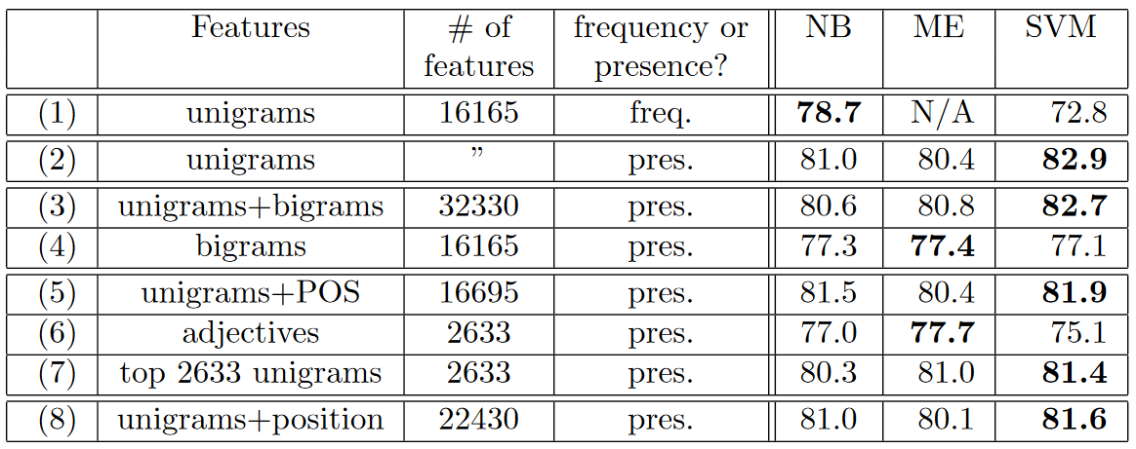
Text Classification
Sentiment Classification
Linguistic Features
Thumbs up? Sentiment Classification using Machine Learning Techniques, EMNLP’2002.

Slide 17
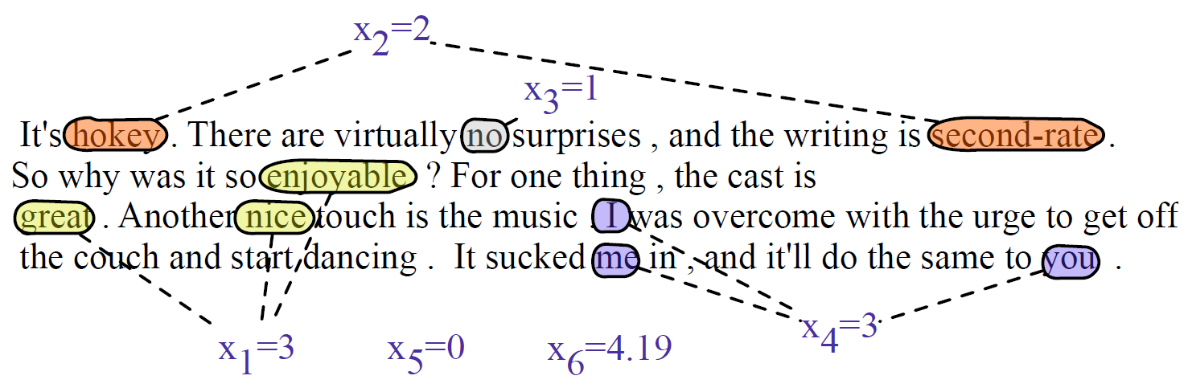
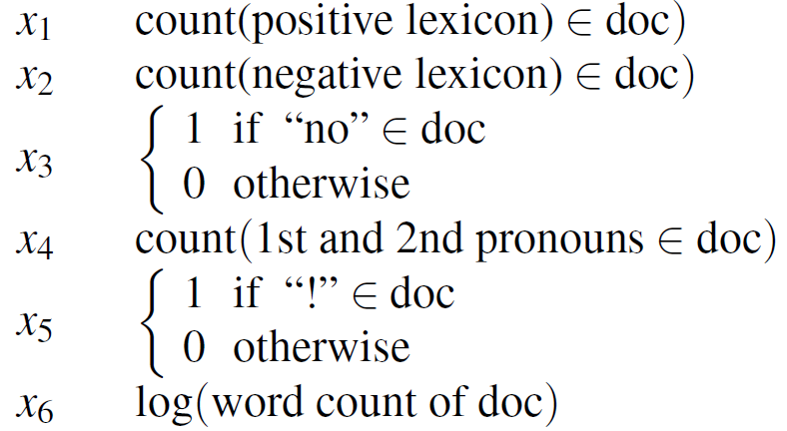
Text Classification
Sentiment Classification
Other Statistic and Specially Designed Features
Binary Feature
Integer Feature
Real Value Feature
Notes:
P78:

Slide 18
Text Classification
Email Spam Detection
Specially Designed Linguistic Features
Email subject line is all capital letters.
Email subject line contains “online pharmaceutical”.
Contains phrases of urgency like “urgent reply”.
Claims you can be removed from the list.
HTML has unbalanced “head” tags.
….
Notes:
[ˌfɑrməˈsutɪk(ə)l]

Slide 19
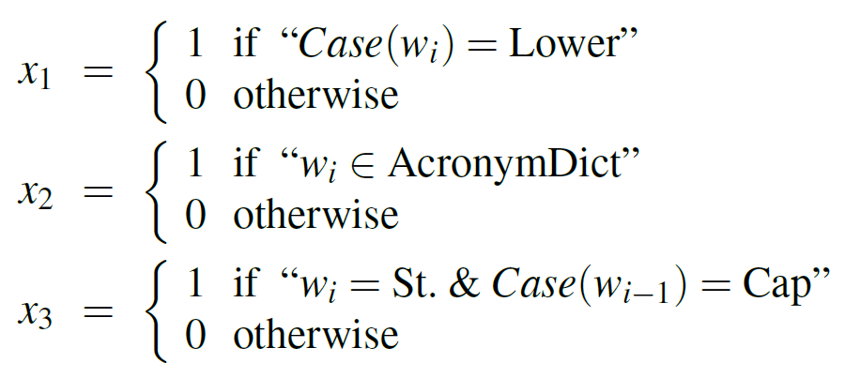
Text Classification
Period Classification (End of Sentence or Not)
Specially Designed Linguistic Features
Composite (Combination) Feature
Notes:
acronym 缩略语
For example a period following an upper case word is likely to be an EOS, but if the word itself is St. and the previous word is capitalized, then the period is likely part of a shortening of the word street.

Slide 20
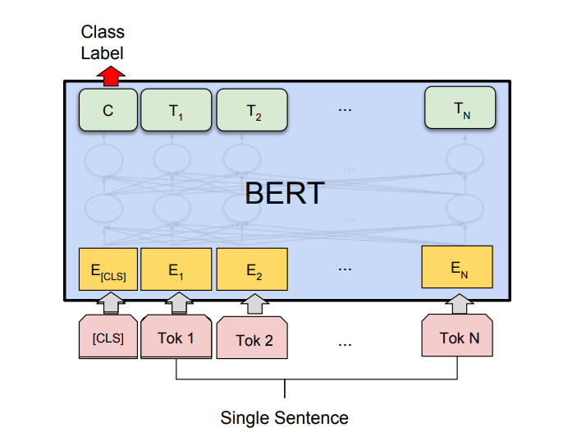
Text Classification
Representation of Input Text
Feature Engineering: Features are generally designed by examining the training data set with an eye to linguistic intuitions and the linguistic literature on the domain.
In statistical natural language processing, feature design or feature selection is very important.
Representation Learning: In order to avoid the extensive human effort of feature design, recent research in neural natural language processing has focused on representation learning.
Bidirectional Encoder Representations from Transformers (BERT)

Slide 21
Text Classification
Chinese Word Segmentation via Classification
Homework: Chinese word segmentation can be cast to a binary or multi-class classification problem. Do you have any idea how to apply a typical classification model (such as SVM, Naïve Bayes) to segment a given Chinese sentence into a sequence of words?

Slide 22


Text Ranking
Text Similarity (in Information Retrieval)
Queries are treated as very short documents.
An information retrieval model needs a way to calculate the similarity between a query vector and a document vector as a measure of the relevance score of the document for that query (denoted by sim(d, q) or score(d, q)).
Documents
Document Representation
Ranked
Documents
Document Ranking
Query
Query Representation

Slide 23
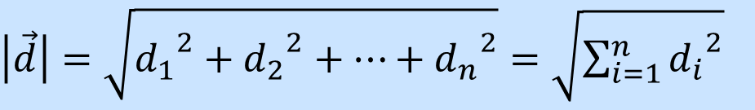
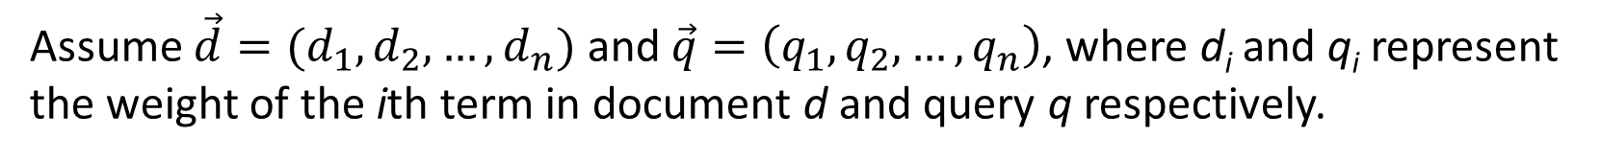
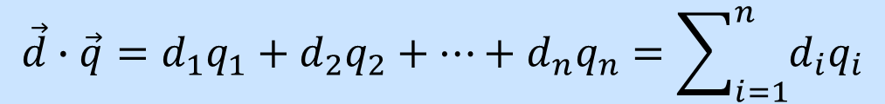
Text Ranking
Text Similarity
Euclidean Length of a Vector
Dot Product
Assume $\vec{d}=(d_{1},d_{2},…,d_{n})$ and $\vec{q}=\left(q_{1},q_{2},…,q_{n}\right)$, where d_{i} and q_{i} represent the weight of the ith term in document d and query q respectively.
$\left|\vec{d}\right|=\sqrt{{d_{1}}^{2}+{d_{2}}^{2}+…+{d_{n}}^{2}}=\sqrt{\sum_{i=1}^{n}{{d_{i}}^{2}}}$
$$\vec{d}∙\vec{q}=d_{1}q_{1}+d_{2}q_{2}+…+d_{n}q_{n}=\sum_{i=1}^{n}{d_{i}q_{i}}$$

Slide 24



Text Ranking
Text Similarity
Cosine Similarity
Numerator: Dot Product
$sim(\vec{d},\vec{q})=cos(\vec{d},\vec{q})$
$$=\frac{\sum_{i=1}^{n}{d_{i}q_{i}}}{\sqrt{\sum_{i=1}^{n}{{d_{i}}^{2}}}\sqrt{\sum_{i=1}^{n}{{q_{i}}^{2}}}}$$
Euclidean Normalization
$$=\frac{\vec{d} ∙ \vec{q}}{\left|\vec{d}\right| \left|\vec{q}\right|}$$
Denominator: Euclidean Lengths
Notes:
Numerator vs. Denominator

Slide 25
Text Ranking
Text Similarity
Document Set | d1 | d2 | d3 | d4
t1 | 1 | 0 | 0 | 1
t2 | 0 | 1 | 0 | 1
t3 | 0 | 1 | 1 | 1
t4 | 0 | 1 | 1 | 0
t5 | 1 | 1 | 0 | 1
Query | q
t1 | 1
t2 | 0
t3 | 0
t4 | 0
t5 | 1
Notes:
Numerator vs. Denominator

Slide 26
Text Ranking
[1] TF-IDF Weighed Vector Representation
 | d1 | d2 | d3 | d4
t1 | 1×log(4/2)=0.30 | 0 | 0 | 1×log(4/2)=0.30
t2 | 0 | 1×log(4/2)=0.30 | 0 | 1×log(4/2)=0.30
t3 | 0 | 1×log(4/3)= 0.12 | 1×log(4/3)= 0.12 | 1×log(4/3)= 0.12
t4 | 0 | 1×log(4/2)=0.30 | 1×log(4/2)=0.30 | 0
t5 | 1×log(4/3)= 0.12 | 1×log(4/3)= 0.12 | 0 | 1×log(4/3)= 0.12
 | q
t1 | 1×log(4/2)=0.30
t2 | 0
t3 | 0
t4 | 0
t5 | 1×log(4/3)= 0.12
0.3
0
0
0
0.12
0
0.30
0.12
0.30
0.12
0
0
0.12
0.30
0
0.30
0.30
0.12
0
0.12
0.30
0
0
0
0.12
d₁=
d₂=
d₃=
d₄=
q=
Notes:
Numerator vs. Denominator

Slide 27

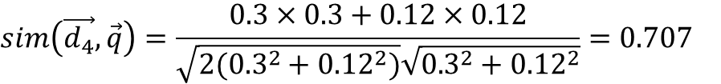

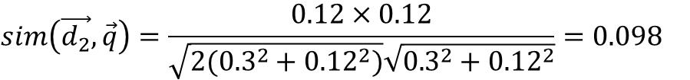
Text Ranking
[2] Cosine Similarity
Question: Can you tell the scores for d1 and d3 without performing any calculation?
$$sim\left(\vec{d_{1}},\vec{q}\right)=\frac{0.3×0.3+0.12×0.12}{\sqrt{{0.3}^{2}+{0.12}^{2}}\sqrt{{0.3}^{2}+{0.12}^{2}}}=1$$
$$sim\left(\vec{d_{3}},\vec{q}\right)=\frac{0}{\sqrt{{0.3}^{2}+{0.12}^{2}}\sqrt{{0.3}^{2}+{0.12}^{2}}}=0$$
$$sim\left(\vec{d_{2}},\vec{q}\right)=\frac{0.12×0.12}{\sqrt{{2(0.3}^{2}+{0.12}^{2})}\sqrt{{0.3}^{2}+{0.12}^{2}}}=0.098$$
$$sim\left(\vec{d_{4}},\vec{q}\right)=\frac{0.3×0.3+0.12×0.12}{\sqrt{{2(0.3}^{2}+{0.12}^{2})}\sqrt{{0.3}^{2}+{0.12}^{2}}}=0.707$$
 | d1 | d2 | d3 | d4
similarity | 1 | 0.098 | 0 | 0.707
 | d1 | d2 | d3 | d4
similarity | 1 | 0.098 | 0 | 0.707
[3] Document Rank
Ranked Retrieval Result | d1 | d4 | d2 | d3
Ranked Retrieval Result | d1 | d4 | d2
Notes:
Numerator vs. Denominator

Slide 28
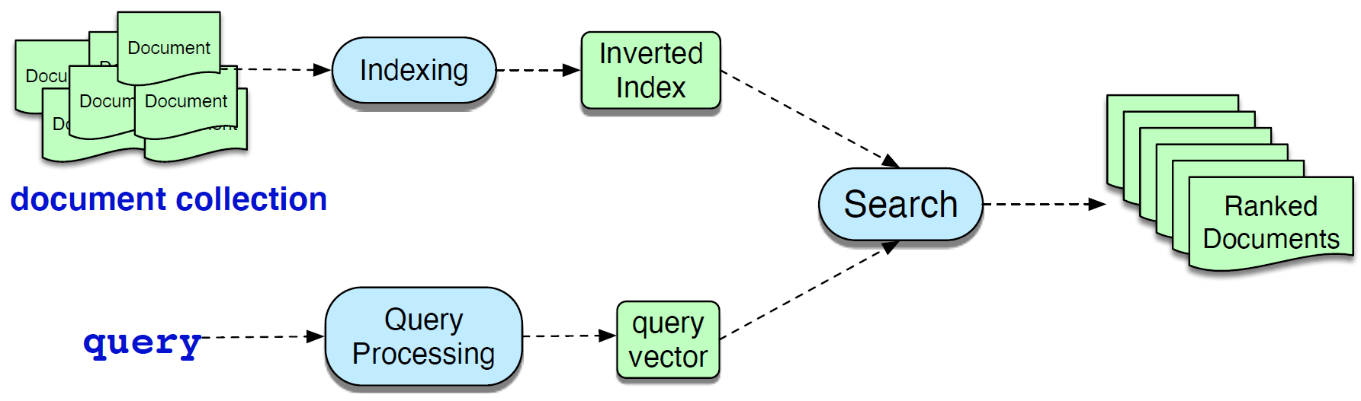
Text Ranking
Information Retrieval
It is the data structure used for making search efficient and also conveniently storing useful information like df and tf.
Architecture of Information Retrieval
Notes:
2020: Chapter 23 P465
In order to compute scores, we need to efficiently find documents that contain words in the query. The basic search problem in IR is thus to find all documents d in C that contain a term q in Q. The data structure for this task is the inverted index, which we use for making this search efficient, and also conveniently storing useful information like the document frequency and the count of each term in each document.
An inverted index, given a query term, gives a list of documents that contain the term. It consists of two parts, a dictionary and the postings. The dictionary is a list of terms (designed to be efficiently accessed), each pointing to a postings list for the term. A postings list is the list of document IDs associated with each term, which can also contain information like the term frequency or even the exact positions of terms in the document. The dictionary can also start the document frequency for each term

Slide 29
Text Ranking
Information Retrieval
An inverted index is a list of documents that contain the term.
computer → d₁, d₂, d₃
document → d₂
filtering → d₃
information → d₁ , d₃
language → d₁
library → d₂
retrieval → d₂, d₃
software → d₁
Query
information
computer
information
language
software
computer
document
library
retrieval
computer
information
retrieval
filtering
d₁
d₂
d₃
Inverted Index File
Dataset
Notes:
2020: Chapter 23 P469
An inverted index, given a query term, gives a list of documents that contain the term. It consists of two parts, a dictionary and the postings. The dictionary is a list of terms (designed to be efficiently accessed), each pointing to a postings list for the term. A postings list is the list of document IDs associated with each term, which can also contain information like the term frequency or even the exact positions of terms in the document. The dictionary can also start the document frequency for each term.

Slide 30
Text Ranking
Information Retrieval
The inverted index consists of two parts, a dictionary and the postings.
The dictionary is a list of terms, each pointing to a postings list for the term. The dictionary can also contain the document frequency for each term.
Index Terms
Document IDs
A postings list is the list of document IDs associated with each term, which can also contain information like the term frequency or even the exact positions of terms in the document.
computer {3}
1 [1]
2 [2]
3 [1]
information {2}
1 [1]
3 [3]
software {1}
1 [1]
A Linked List for Each Term
Sorted Alphabetically
…
Dictionary
(Vocabulary or Lexicon)
Postings
Sorted by Document IDs
Notes:
2020: Chapter 23 P469
An inverted index, given a query term, gives a list of documents that contain the term. It consists of two parts, a dictionary and the postings. The dictionary is a list of terms (designed to be efficiently accessed), each pointing to a postings list for the term. A postings list is the list of document IDs associated with each term, which can also contain information like the term frequency or even the exact positions of terms in the document. The dictionary can also start the document frequency for each term.

Slide 31
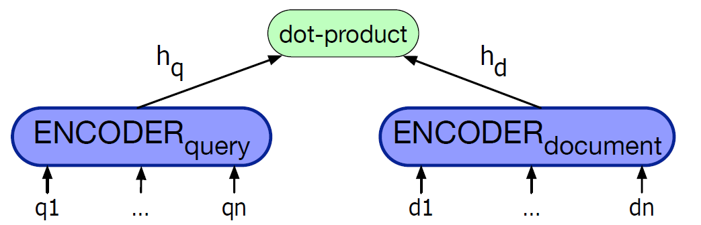
Text Ranking
Dense Retrieval
Vocabulary Mismatch Problem: Synonyms
From Sparse BOW Vectors to Dense Embeddings
BERT: Pretraining of Deep Bidirectional Transformers for Language Understanding (Google AI Language), arXiv’2018
Average Pooling
BERT Bi-Encoder for Computing Revelance of a Document to a Query
Notes:
begin/start, fast/quick, true/correct, home/house, ….
2020: Chapter 23.1 P472
The classic tf-idf or BM25 algorithms for IR have long been known to have a conceptual flaw: they work only if there is exact overlap of words between the query and document. In other words, the user posing a query (or asking a question) needs to guess exactly what words the writer of the answer might have used to discuss the issue.
The solution to this problem is to use an approach that can handle synonymy: instead of (sparse) word-count vectors, using (dense) embeddings. This idea was proposed quite early with the LSI (Latent Semantic Indexing) approach, but modern methods all make use of encoders like BERT. In what is sometimes called a bi-encoder we use two separate encoder models, one to encode the query and one to encode the document, and use the dot product between these two vectors as the score.

Slide 32
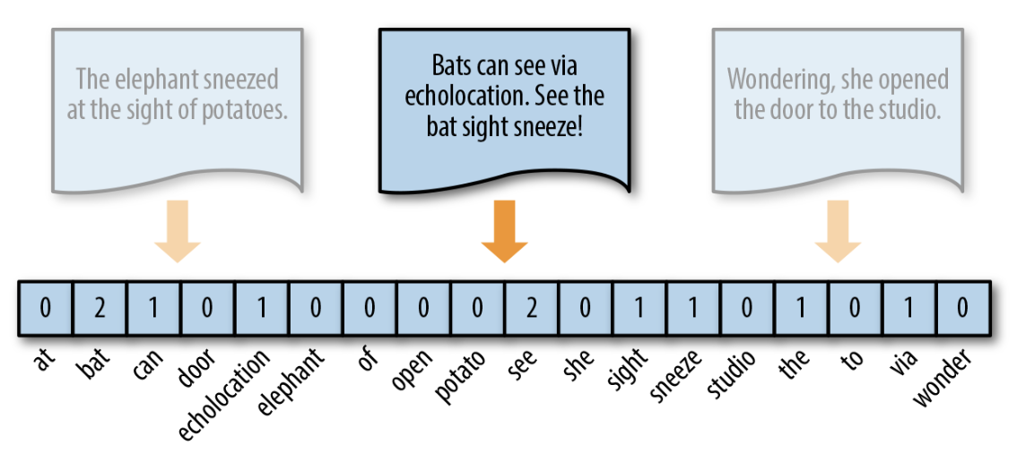
Text Ranking
Dense Retrieval
From Sparse BOW Vectors to Dense Embeddings
BOW Representation
Embedding
0.5 | 0.8 | -0.1 | 0.2 | -0.6 | -0.5 | -0.1 | 0.7 | 0.4 | 0.3
Notes:
2020: Chapter 23.1 P472
The classic tf-idf or BM25 algorithms for IR have long been known to have a conceptual flaw: they work only if there is exact overlap of words between the query and document. In other words, the user posing a query (or asking a question) needs to guess exactly what words the writer of the answer might have used to discuss the issue.
The solution to this problem is to use an approach that can handle synonymy: instead of (sparse) word-count vectors, using (dense) embeddings.

Slide 33
References
Book Chapters
Speech and Language Processing
Chapter 4: Naive Bayes, Text Classification and Sentiment (NB)
Chapter 5: Logistic Regression (LR)
Chapter 14.1: Information Retrieval

Slide 34
References
Book Chapters
Introduction to Information Retrieval
Chapter 6: Scoring, Term Weighting and the Vector Space Model
Chapter 11: Probabilistic Information Retrieval
Chapter 12: Language Models for Information Retrieval
Chapter 13: Text Classification and Naive Bayes (NB)
Chapter 14: Vector Space Classification (k-NN)
Chapter 15: Support Vector Machines and Machine Learning on Documents (SVM)

Slide 35


References
Reference Books
Sentiment Analysis and Opinion Mining
Sentiment Analysis: Mining Sentiments, Opinions, and Emotions

Slide 36
Announcement
Lab 1
Venue: PQ604A/B/C
Time: 6:30pm ~ 9:20pm
Date: Tuesday, February 11, 2025
Tutor: Heming Xia

Slide 37


